Slide 1
The Biosynthesis of Carbohydrates
Lecture 6
Exercises
Solutions
31.03.2025

Slide 2
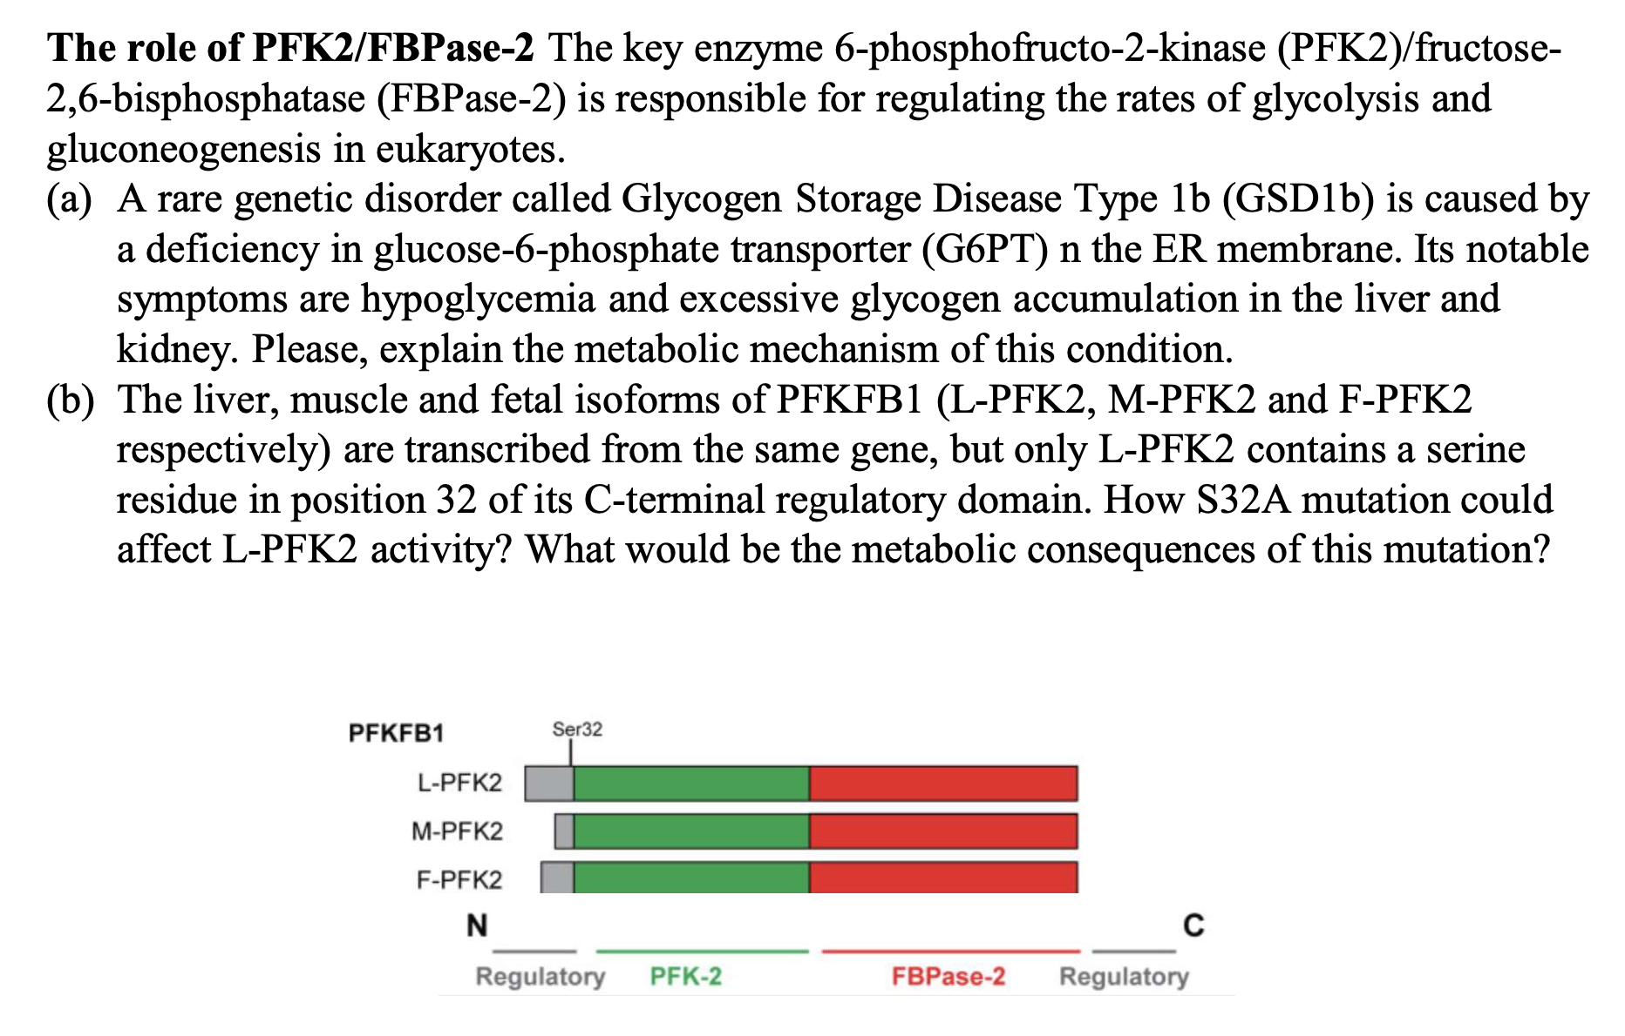
Question 1

Slide 3
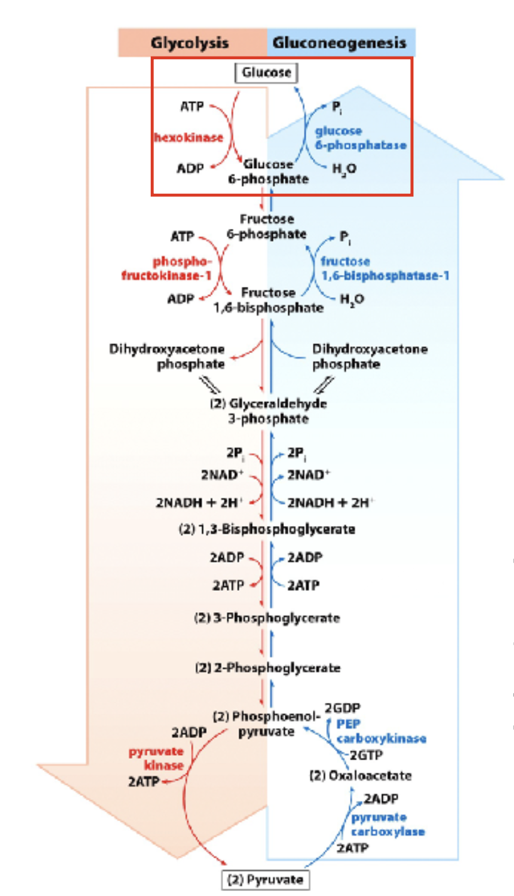
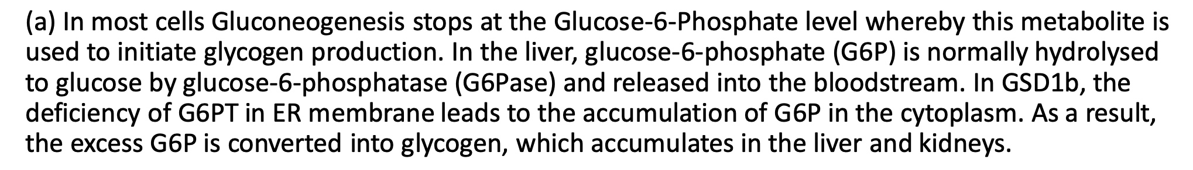
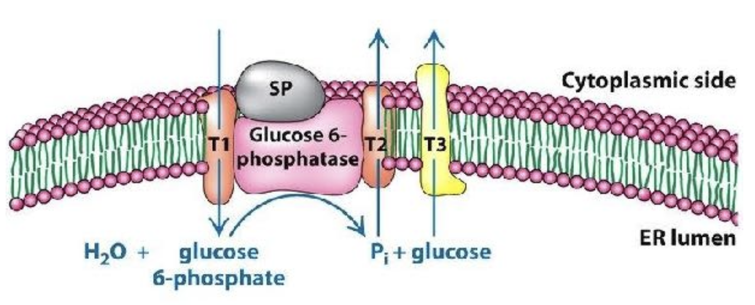
Solution 1a
X

Slide 4
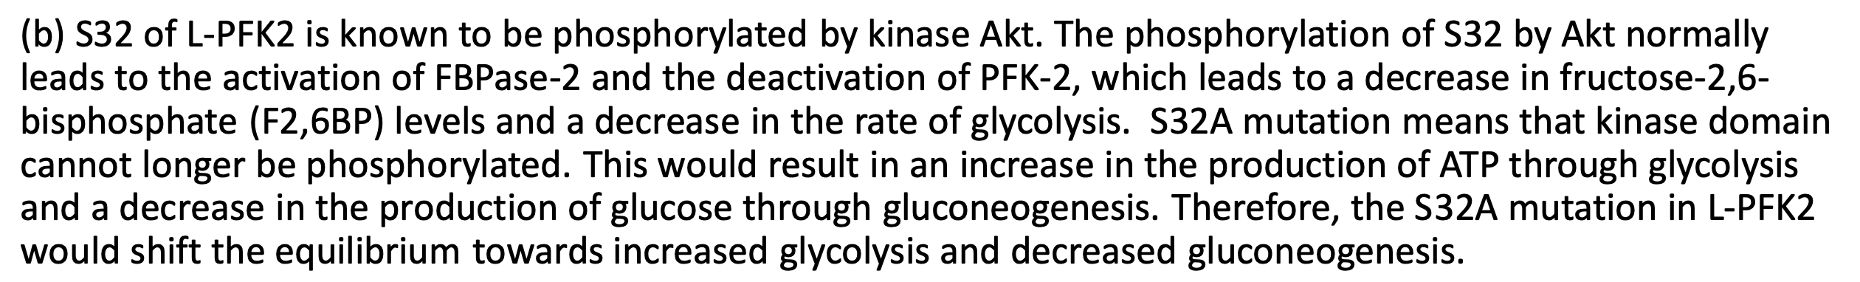
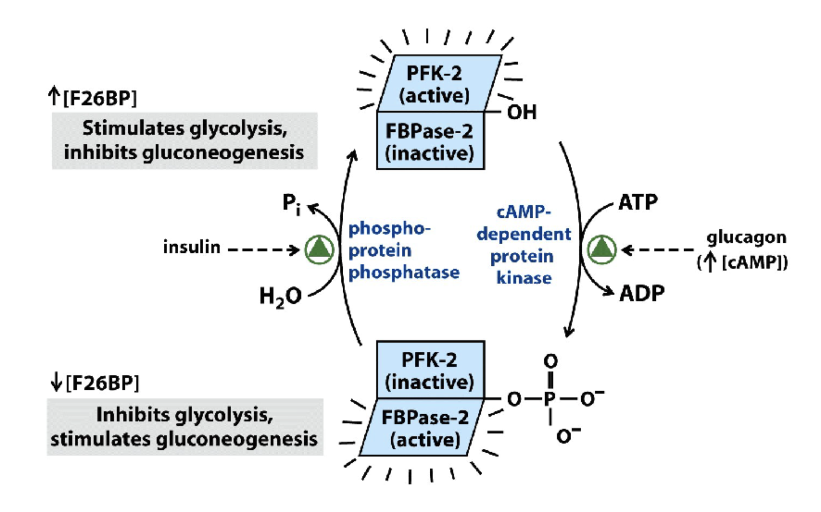
Solution 1b

Slide 5
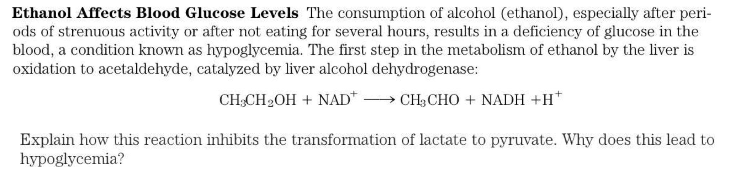
Question 2

Slide 6
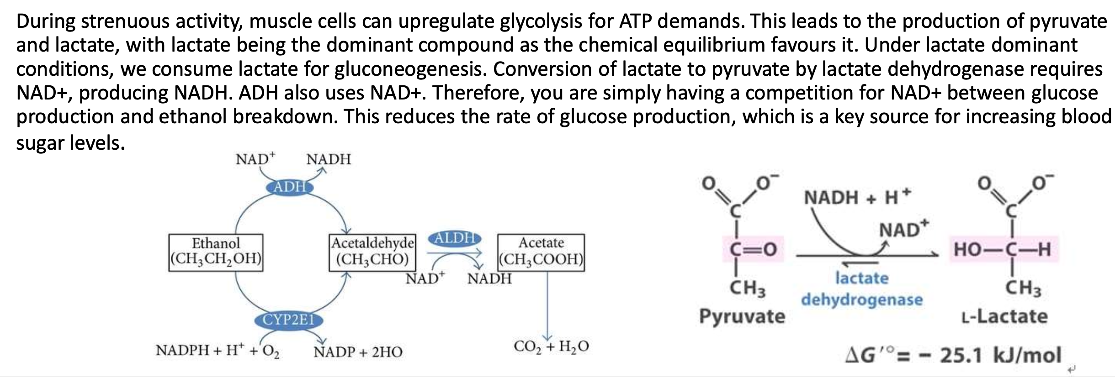
Solution 2

Slide 7
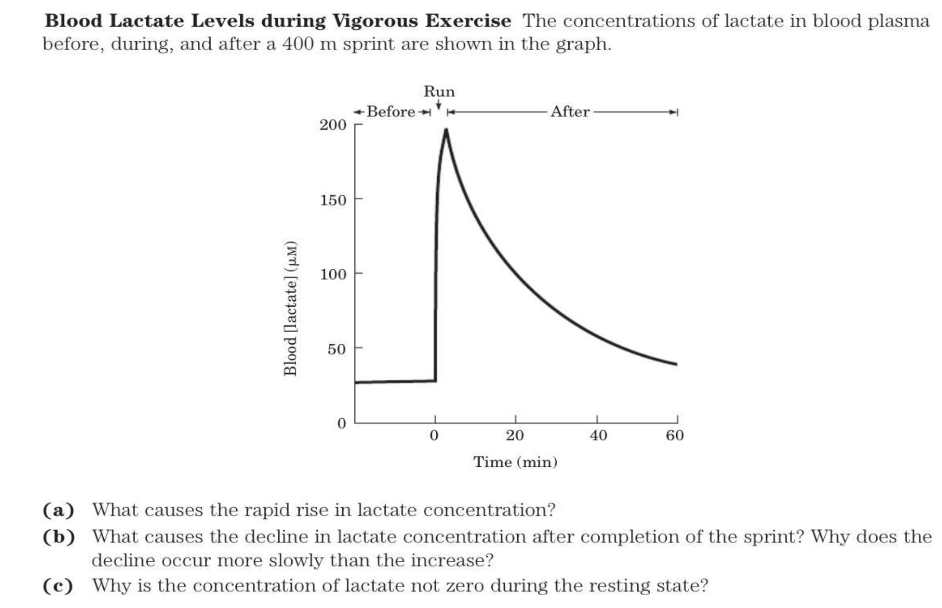
Question 3

Slide 8
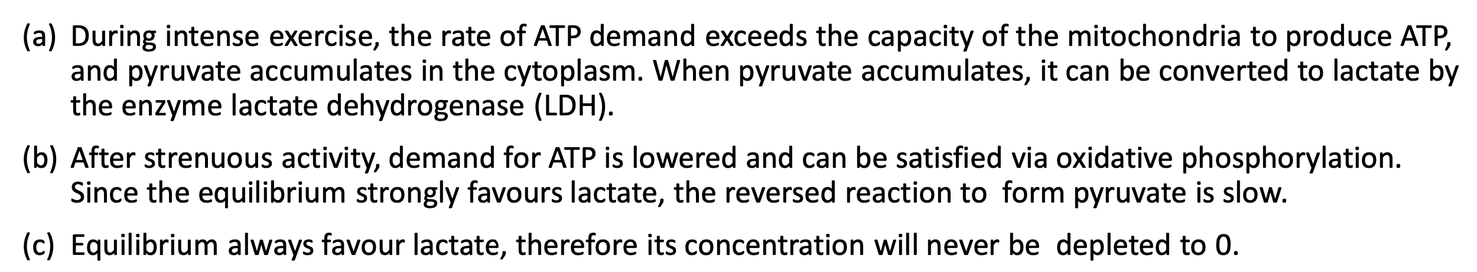
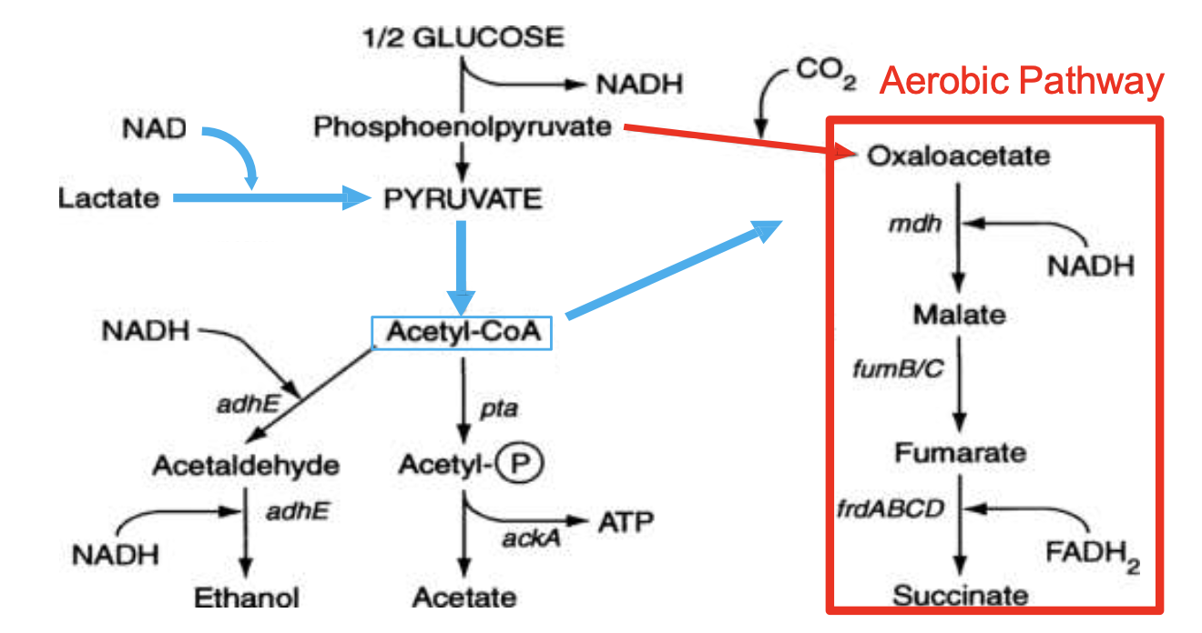
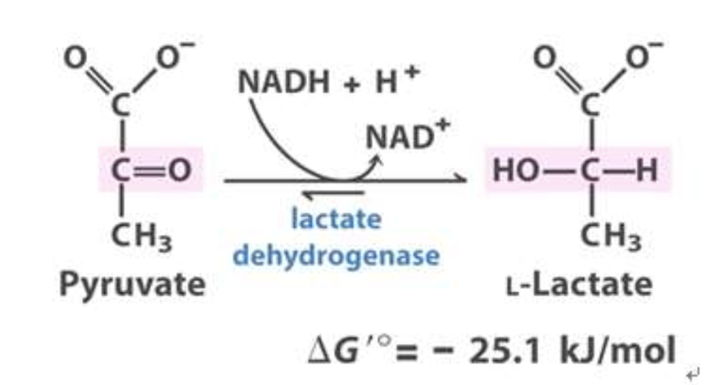
Solution 3

Slide 9
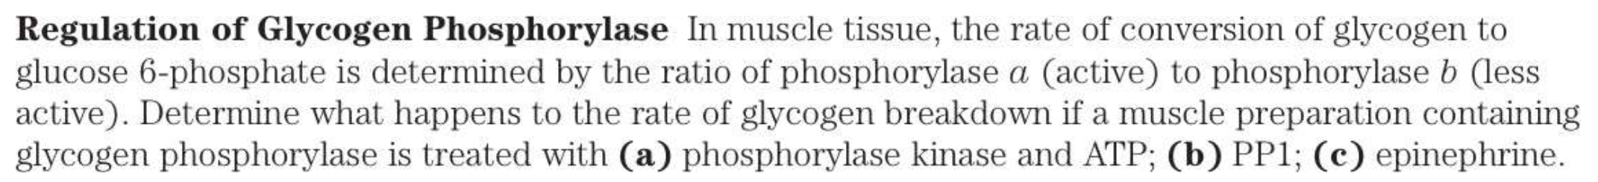
Question 4

Slide 10
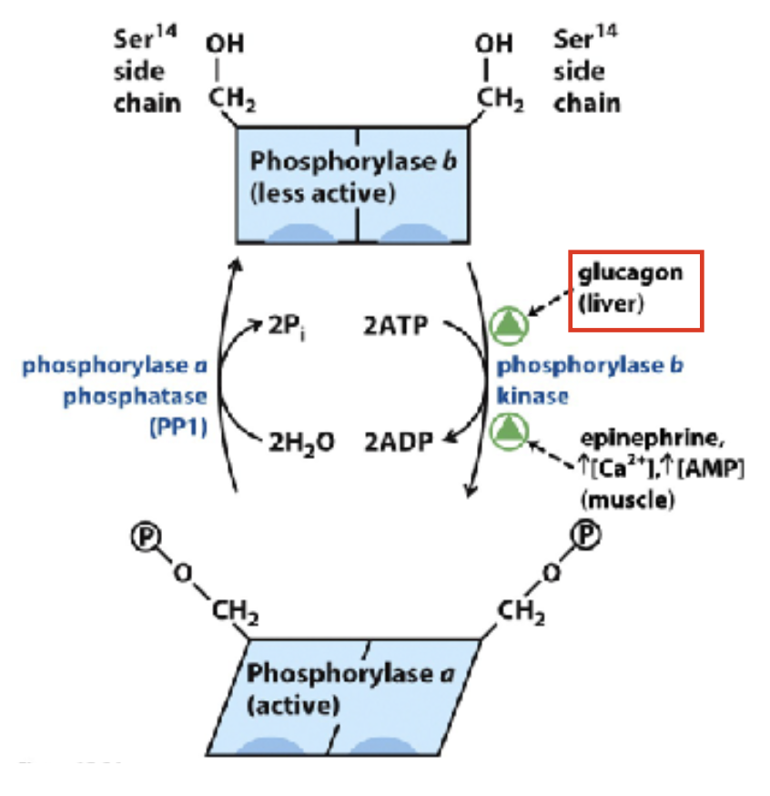
Solution 4
a) Glycogen Breakdown Increase
b) Glycogen Breakdown decrease
c) Glycogen Breakdown Increase

Slide 11
Question 5

Slide 12
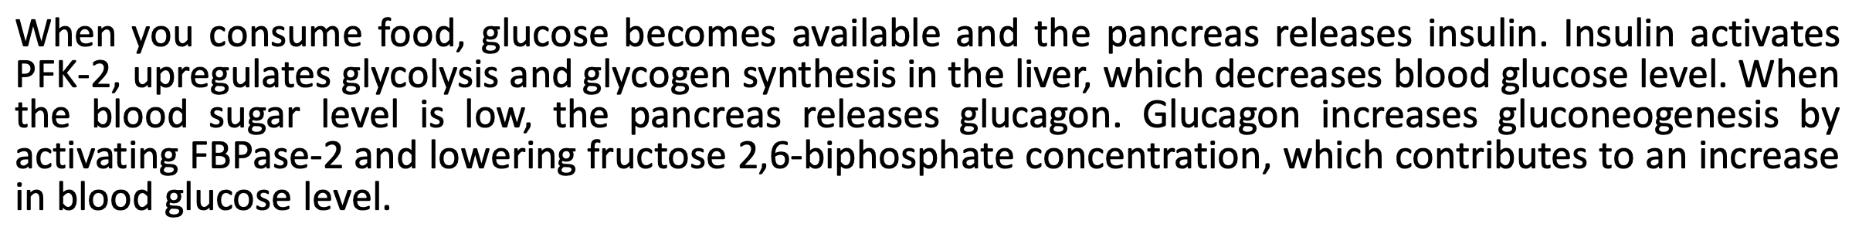
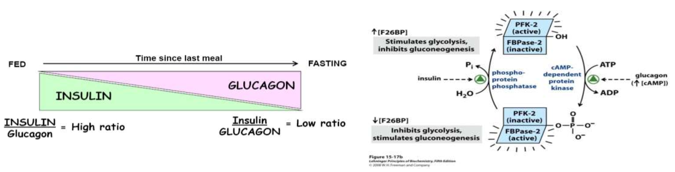
Solution 5

Slide 13
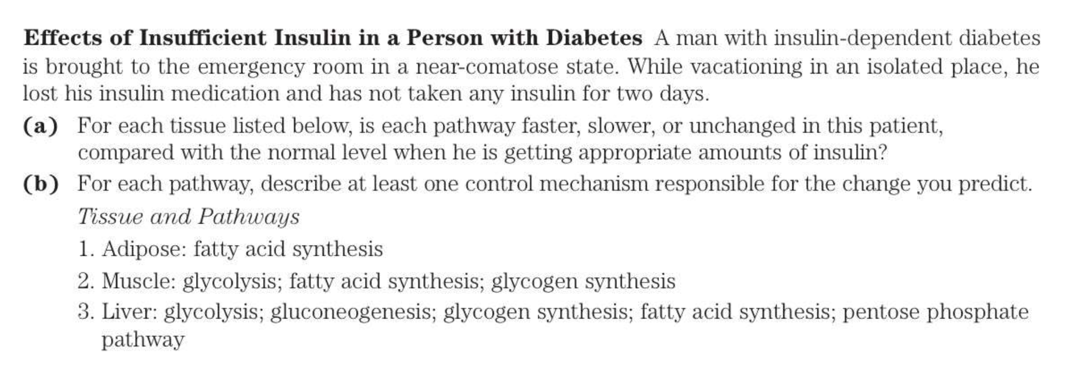
Question 6

Slide 14
Solution 6.a
Adipose Tissue: Fatty Acid Synthesis SLOWER
Insulin secretion → Glucose Uptake by GLUT4 → Fatty Acid Synthesis
(No or lower insulin, no glucose uptake into adipocytes and lowering fatty acid synthesis)
Muscle: Glycolysis SLOWER, FA Synthesis SLOWER, Glycogen Synthesis SLOWER
Insulin secretion → Glucose Uptake by GLUT4 → Glycolysis, Glycogenesis, FA synthesis
(No or lower insulin, no glucose uptake into skeletal muscle cells and lowering glycolysis, glycogen synthesis and fatty acid synthesis)
Liver: Glycolysis SLOWER, gluconeogenesis FASTER, Glycogen synthesis SLOWER, fatty acid synthesis SLOWER, pentose phosphate pathway UNCHANGED
(No or lower insulin, no glucose uptake into liver cells and lowering glycolysis, glycogen synthesis and fatty acid synthesis, while increasing the rate of gluconeogenesis due to lower glucose amount and it would not affect PPP, which is directly regulated by cellular redox state and biosynthesis demands rather than insulin signaling.)

Slide 15
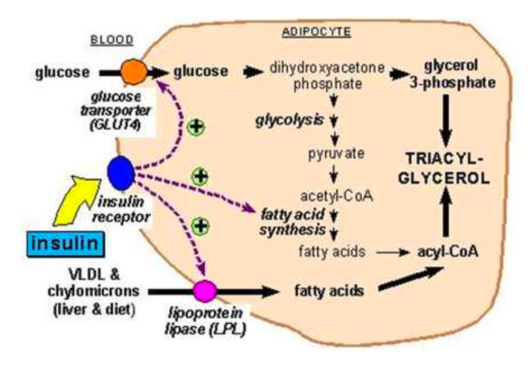
Solution 6.b
Adipose tissue: Insulin facilitates entry of glucose into adipocytes via GLUT4. Within those cells, glucose can
be used to synthesize glycerol. This glycerol, along with the fatty acids synthesized, are used to synthesize
triglyceride within the adipocyte.

Slide 16
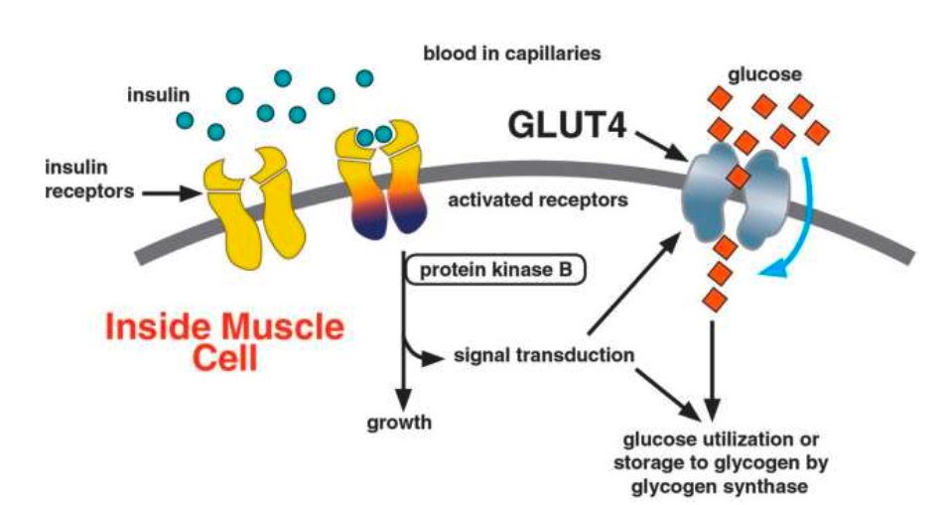
Solution 6.b
Muscle: Similar to the adipose tissue, fatty acid synthesis is coupled with glucose import via GLUT4.
Without insulin = reduced FA synthesis.
Glycogen synthesis is also reduced in the absence of glucose.
If GLUT4 is inactive, glycolysis would also be slowed down due to lack of glucose import (in the absence of insulin).

Slide 17
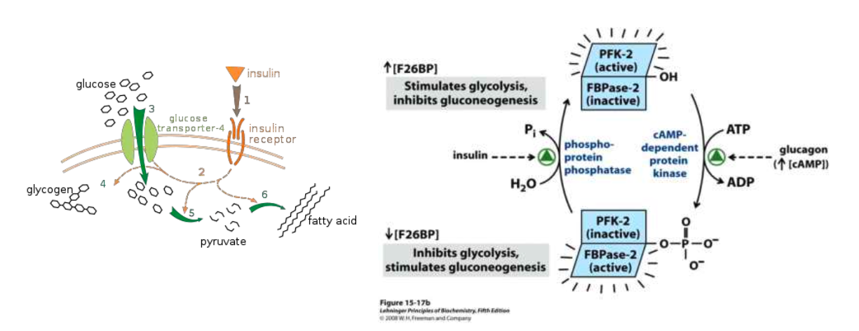
Solution 6.b
Liver: Insulin stimulates glycogen production and fatty acid production in the liver.
No insulin = slow down in glycogen + FA production.
Insulin stimulates glycolysis via upregulation of phosphatase.
Increased glucagon = inactive FBPase-2 = stimulation of gluconeogenesis and inhibition of glycolysis.
Insulin has no effect on the pentose phosphate pathway.

